Slide 1
Predicting the marketing strategy of e-commerce products based on text big data
Members:
Ding Lichao
Hu Zijiao
2021.10.30

Slide 2
CONTENTS
1
Introduction
2
Data acquisition&
Data Clean
3
Vader Sentiment
Analysis
4
Training a Model to Predict
Star-rating

Slide 3
CONTENTS
5
Analytic Hierarchy Process
Based on
Information Entropy
6
Relationship between
Speciﬁc Negative Description and Rating Leveling
7
Wordcloud
8
Conclusion

Slide 4
1
Introduction

Slide 5

A brief introduction of our project
1
In the online marketplace, most electronic business platforms provide customers with opportunities to rate and review purchases.The Review and Rating System has been playing a huge role during the evolution of E-commerce. Customers use it to help make the best purchase decisions, while vendors can utilize it to collect opinions on how to make improvements.
Therefore, it is of essential to extract the most valuable information out of mountains of customers’voices.

Slide 6
2
Data acquisition&
Data Clean

Slide 7
Data acquisition&Data Clean
2
Based on customers can submit these:
1.Individual ratings
Allow purchasers to express their level of satisfaction with a product using a scale of 1 (low rated, low satisfaction) to 5 (highly rated, high satisfaction).
2.Text-based messages
Reviews that express further opinions and information about the product.
3.Helpfulness ratings
Ratings on these reviews as being helpful or not , towards assisting their own product purchasing decisions.

Slide 8
Data acquisition&Data Clean
2
The data set contains the following:
●marketplace（string）
●customer_id（string）
●review_id（string）
●product_id（string）
●product_parent（string）
●product_title（string）
●product_category（string）
●star_rating（int）
●helpful_votes（int）
●total_votes（int）
●vine（string）
●verified_purchase（string）
●review_headline（string）
●review_body（string）
●review_date（bigint）

Slide 9
Data acquisition & Data Clean
2
Data Clean
We need to:
●Delete reviewers didn’t buy the products actually.
●Delete the column of marketplace and product_category.
●Rearrange index.
Then we will get a new data set after cleaning.

Slide 10
3
Vader Sentiment
Analysis

Slide 11
Vader Sentiment Analysis
3
Call the Library
from vaderSentiment.vaderSentiment import SentimentIntensityAnalyzer
import csv
input_file = open('review_body_pacifier.txt',encoding='utf-8')
output_file = open("review_sentiment.txt", mode="w",encoding='utf-8')
csv_writer = csv.writer(output_file)
sentences = input_file.readlines()
analyzer = SentimentIntensityAnalyzer()
for sentence in sentences:
vs = analyzer.polarity_scores(sentence)
csv_writer.writerow([sentence,vs['compound']])
output_file.write(str(sentence)+str(vs['compound'])+'n')
input_file.close()
output_file.close()
Output: Sentiment Score of each reviews

Slide 12
4
Training a Model to Predict Star-rating

Slide 13
Training a Model to Predict Star-rating
4
In this part, we analysized the relationship between reviews’ texts and star-ratings. We train a model (from xgboost import XGBClassifier) and it can predict the star-ratings the users will give based on the reviews.
Input: reviews
Process:
Rebalance data
Split data
Fit data in a matrix and train model
Make predictions for test data
Evaluate predictions
Output:
Star-rating (Users may give based on this review)

Slide 14
Training Model to Predict Star-rating
4
Accuracy: 88.41%
Example
Input:
"This is the worst product. I will never buy this again!"
"I love it so much."
"Looks fine to me, but too expensive."
Output:
[1,5,3]

Slide 15
5
Analytic Hierarchy Process Based on
Information Entropy

Slide 16
Analytic Hierarchy Process Based on Information Entropy
5
Information entropy is a value that measures the amount of information carried by a set of data. We used the information entropy of star_rating, help_factors and review_score as a reference to evaluate the amount of information contained in each factor. In order to deﬁne the scores that described product evaluation, we established an AHP model (The Analytic Hierarchy Process). By comparing the importance to the score among the three factors, we assigned certain weight to each factor, so as to get the evaluation system.We established a AHP model, which focuses on the following three aspects:
1.Star_rating
2.Useful evaluation coefﬁcient H
3.Review

Slide 17
Analytic Hierarchy Process Based on Information Entropy
5
In order to reduce the inﬂuence brought by the subjective effect of AHP model, we use infor- mation entropy to help determine the weight of three factors. Information entropy is a measure that represents the uncertainty of random variables.
The greater the value of information entropy, the greater the uncertainty of random variables. So we can use information entropy to measure the information contained in a random variable. According to the above principle, we calculated the information entropy of the three factors of the three products. The results are as follows:
star_rating:
0.4693001370880815
helpful_votes
0.03781104985313568
review_scores
0.49858726073827164
Through the weight of the three factors, we can get the comprehensive satisfaction score of the products.

Slide 18
6
Relationship between Specific Negative Description and Rating Leveling

Slide 19
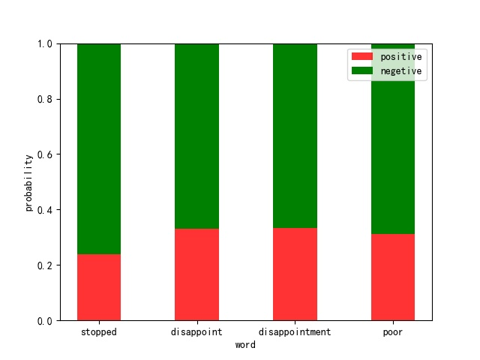
Relationship between Specific Negative Description and Rating Leveling
6
For several words with negative emotions, we counted the probability that these words appear in the reviews with low quality star rating. From the ﬁgure, we can see that these words have a relatively large degree of discrimination in scoring. If these words appear in comments, the corresponding scoring will often be linked to their negativity. However, not all words have similar discrimination, such as some unrelated words (price) or some neutral words (much). These words have no discrimination for scoring, so we think these words have no direct relationship with the rating level.

Slide 20
7
Wordcloud of the Reviews

Slide 21
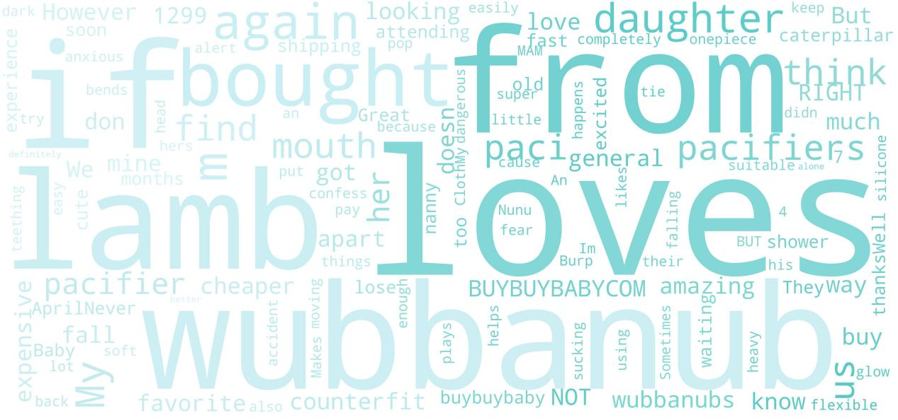
Wordcloud of the Reviews
7

Slide 22
8
Conclusion

Slide 23
Conclusion
8
Star rating and sentiment score of reviews play a decisive role in the overall evaluation of goods.
Lower star rating usually relates with lower scores. Watch out for comments with certain negative words, which can lead to lower ratings.
Therefore, we suggest that company invite customer experiencers to experience and evaluate the products after its marketing, which will give consumers more reference information and promote their purchase.

Slide 24
Thank you for listening
Members:
Di Lichao
Hu Zijiao

